Slide 1
English on the World Stage
Dakota TESOL Conference
Fall 2023
Missy Slaathaug
Emily Wodahl

Slide 2
Get ready to have your mind expanded!
English is English, right? There is only one English…
Well, Australian and British English - but those are just cute accents, right?
Let’s think about all this a completely different way - and open the door to -
World Englishes!
also called New Englishes, Nativized Varieties

Slide 3
Some definitions
Sociolinguists have different ways of categorizing and naming types of languages according to:
status
social function
touching on one of my favorite themes here:
ANY analysis of language and how it functions in society comes down to economics and power

Slide 4
What do we mean by
standard languages?
pretty slippery! many different uses among linguists.
Some criteria:
is written
some degree of standardisation (grammar/dictionary)
has some prestige in the community
used for official/administrative (H) functions

Slide 5
How did English become a standard variety?
It was all about who had the power and the money in British society.
In English - 15th century, there were a variety of regional dialects.
What we know as “standard English” emerged because it was spoken by the English Royalty and also the influential merchants of London.
London was the center of political, social and intellectual life. Literature, business and trade, fashion, royal intrigue, official and government functions all used this dialect. It became codified and stabilized and it spread.

Slide 6
So - English met these three criteria and attained this status as a standard variety:
prestige
codified/stabilized
used for official/administrative (H) functions
“It is simply the dialect of those who are politically powerful and socially prestigious.”
Holmes and Wilson, p. 83

Slide 7
once recognised as the standard…
The variety gains institutional support:
educational institutions teach it and promote it
the media uses it
most administrative agencies support and use it
Notes:
So - this holds true for our World Englishes, as we will see. These are important concepts: Institutional support. The language becomes woven formally into society…

Slide 8
Lingua Franca
A language regularly used for communicating between two groups in a multilingual speech community who speak different first languages.
They have to communicate somehow?
So a third language may fill that void - both groups learn it and use it.
Often developed initially as trade languages

Slide 9
Lingua Franca continued…
Hausa - West Africa
Swahili - East Africa
Russian - in former Soviet Union
French - used to be the language of diplomacy in Europe and parts of Asia
Former colonies - often the language of the colonizer
and today - ENGLISH

Slide 10
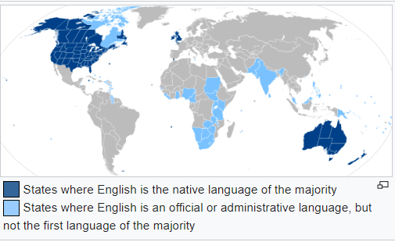

Slide 11
World Englishes
Different varieties of English that have developed in the last 200 years.
Exactly how are they different?

Slide 12
stress
vocabulary
grammatical features
semantic concepts
Often show influence of local languages
Might exist beside a more formal variety of English, used for more H functions - Singapore English / Singlish
Notes:
And NOTE - these are stable PATTERNS - not just random errors. You can identify the patterns and write grammar/pronunciation rules about them - and people have.

Slide 13
Some examples of World Englishes:
Bermudian English, Hong Kong English, Indian English, Irish English, Malaysian English, Philippine English, South African English, Nigerian English, and East African English, Singapore English…

Slide 14
The Three Circles - Braj Kachru
INNER CIRCLE
varieties spoken in countries where English is the first, or dominant language - varieties used by native speakers.
What 5 countries would you put here?
Notes:
Kachru’s Three Circles is one way of analyzing/understanding the role of different varieties of English in the world.
US, UK, Australia, Canada, New Zealand

Slide 15
INNER CIRCLE
varieties spoken in countries where English is the first, or dominant language - varieties used by native speakers.
What 5 countries would you put here?
US UK Canada
Australia New Zealand

Slide 16
OUTER CIRCLE
Varieties used where English is a second language - so English has a long history of important H functions (government, administration, education, literature), and is well-integrated into society but is a second language for these places.
Often these are former colonies.
How many can we list?
Hint: there are a lot - shoot for 14
Notes:
India, Bangladesh, Pakistan, Malaysia, Philippines, Singapore, Sri Lanka, Ghana, Zimbabwe, Tanzania, Kenya, Nigeria, South Africa, Zambia

Slide 17
OUTER CIRCLE
India
Bangladesh
Pakistan
Malaysia
Philippines
Sri Lanka
Singapore
Ghana
Zimbabwe
Tanzania
Kenya
Nigeria
South Africa
Zambia

Slide 18
EXPANDING CIRCLE
Places where English is studied and used as an additional language for business or higher education (scientific or technical study)
What countries do you think would fit here?
Notes:
China, Japan, Taiwan, Korea, Indonesia, Nepal, Egypt, Saudi Arabia, Israel, South America, Caribbean Countries

Slide 19
EXPANDING CIRCLE
China
Japan
Taiwan
Korea
Indonesia
Nepal.
Egypt
Saudi Arabia
Israel
South America
Caribbean Countries

Slide 20
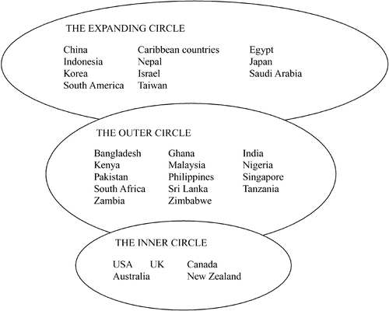

Slide 21
By the numbers….
Native Speakers:
The US - 306 million
India - 265 million
Pakistan - 104 million
UK- 68 million
Nigeria - 60 million
As of 2022, about 373 million native speakers of English
As of 2003, non-native speakers outnumbered native speakers by a ratio of 3:1.
Total number of English speakers? Somewhere between 1.5 billion - 2 billion

Slide 22
WOW!
Here is a head-spinner:
…globalisation means there are now many more speakers of English in the outer and expanding circles than in the inner circle, and with English as the global language of the internet, and computer-mediated communication, it seems likely that variation in old and new Englishes, both written and spoken, is likely to continue to develop.
(emphasis added) Holmes and Wilson, page 85.

Slide 23
Attitudes
Is the non-standard variety and accent somehow inferior?
Whose English is the “best”? Whose is “correct”?
Does it depend on the situation? The context? The participants?

Slide 24
Whose English?
Some excellent resources - cannot recommend these enough.
The first is a 30-minute podcast by Heather Hanson, a woman who has taught English abroad for many years and struggled with this idea of what constitutes good English. The second is her 20-minute TedTalk on the same topic, more or less.
Accent Reduction And How To Speak Global English : Rough Translation : NPR
2 Billion Voices: How to speak bad English perfectly | Heather Hansen | TEDxOdense

Slide 25
Comprehensiblility…
The thinking is - to some extent, if speakers of this variety of English can understand each other - what does it matter if we understand them or not?
Why are learners of English striving to sound like us, when they will mostly be communicating with speakers of other varieties? And maybe it’s up to us to adjust our ears and get used to these differences in a different World English…

Slide 26
One thought to apply to our classrooms…
Non-native speakers are much more hesitant and try less and make more mistakes - when a native speaker is present…

Slide 27
English in India
It has been present since the early 1600s, with the presence of the East India Company and the activities of English Missionaries.
It spread into administrative, business, educational and trade activities over decades.
In 1835, an man named Thomas Babington Macaulay introduced a landmark bill in the British parliament establishing English as the language of instruction for higher education and later, all education in India.

Slide 28
Indian English
People wanting to acquire higher jobs and positions had to learn English. The British rulers wanted to establish a whole new class of Indians who thought like the British and adopted their ideology; they needed Indian clerks and interpreters. Thus Lord Macaulay started what he called his, “civilising mission!”. He wanted to establish a whole new class of people, “Indian in blood and colour, but English in taste, in opinions, in morals, and in intellect.”
Influence of English in India | SBS Hindi

Slide 29
By the early 20th century, English had become the official and academic language of India.

Slide 30
Independence in 1947!
Decreed that Hindi would be the first official language (this favored the Hindi speakers, of course…)
and
temporarily, English, which symbolized former colonizers but was a practical choice to serve as a more neutral lingua franca among so many ethnic groups.

Slide 31
Plan was to phase out English over time -
This didn’t work!
As English become more and more important globally, they embraced it.
Over time it shed the deep connection with colonialism and came to represent modern life and progress.

Slide 32
1965 - Passage of The Language Act
Hindi = the Official Language of India
English = the Associate Official Language
Regional languages = used for administration within each state
Side Note: There are 22 separate official languages
But - there are a total of 121 languages and 270 dialects spoken in India.

Slide 33
Both Hindi and English are official languages today.
Young, educated Indians are primary speakers of English - often learn it in school from a young age. (different from our school foreign language teaching, of course…)
True lingua franca - used in commerce and administration and education to communicate among all different ethnic groups.
Some feel it has led to a new caste system, with access to good education in English really only available to the upper classes

Slide 34
and most importantly for this talk -
It has resulted in Indian English - heavily influenced by the indigenous languages.
You are no doubt familiar with the accent? And if you have any experience with International TAs from India, you may remember difficulties following a lecture…
When I worked with TAs from India at Carnegie Mellon University, I learned the hard way…
Notes:
MY Experiences with TAs from India at Carnegie Mellon - fascinating. I had to watch what I said - I learned the hard way not to tell them they were saying it wrong…

Slide 35
Some Examples of Indian English phrases:
Please do the needful. Meaning: to take care of something.
English-knowing. Used to describe someone who speaks English.
Convent-educated. Refers to someone who received their education in English
I belong to Mumbai. Meaning: I am from Mumbai
Please revert. Meaning: please report back with information.
https://blog.pimsleur.com/2020/07/16/what-are-world-englishes/

Slide 36
YouTube: Do Indians know how their English accent sounds?
Notes:
This video covers lots more than that - touches on the role of English in Indian society today, pride in one’s native language, etc.

Slide 37
Nigerian English: Well done!
An example of different usage in Nigerian English, that comes directly from the Nigerian languages Housa, Yoruba, Igbo or Baatonum.
No direct parallel in Standard American English.
Used to greet a person who is working or just doing something. It doesn’t really have anything to do with how well they are doing the job.
https://dailytrust.com/nigerian-words-and-expressions-that-are-untranslatable-into-english/

Slide 38
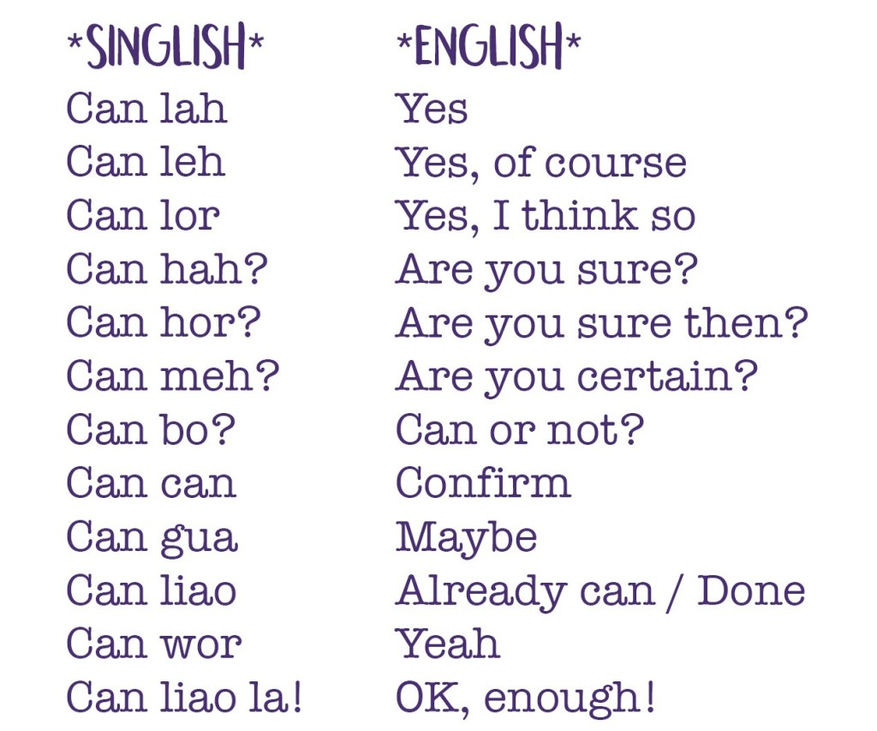
Singlish
Singapore is a real cultural and linguistic melting pot with large communities of people speaking lots of different languages. Besides English, most people here can also understand and speak some Malay, Tamil, and various Chinese languages such as Hokkien, Cantonese, Teochew, and Mandarin, amongst others. Locals often mix up words and grammar from these languages to create the unique and fascinating Singlish.
One cool example of how expressive Singlish can be is the many uses of the word “can”:

Slide 39
references
Farrell, T.S.C. (2017). Sociolinguistics and Language Teaching. tesolpress.
Holmes, J., & Wilson, N. (2017). An Introduction to Sociolinguistics. Routledge.
YouTube:
What Are World Englishes? | The Pimsleur Language Blog
Nigerian words and expressions that are untranslatable into English - Daily Trust
Jetstar goes Singlish, really!
2 Billion Voices: How to speak bad English perfectly | Heather Hansen | TEDxOdense
Podcast:
Accent Reduction And How To Speak Global English : Rough Translation : NPR
Slides theme taken from slidesgo.com

Slide 40
references, continued
Websites:
Influence of English in India | SBS Hindi
World Englishes: An Introduction
History of English in multilingual India: A study in language contact and spread | Education
https://www.oed.com/discover/introduction-to-indian-english/?tl=true
The Languages of India: What Languages are Spoken in India?

Slide 41
Because Jetstar Can…

