Slide 1
Gamifying the Classroom
Terri Schlader
Huron High School
Huron, South Dakota

Slide 2
What is it?
Gamifying the process of learning phrases and vocabulary, with reluctant English as a Second Language (ESL) students, can be an engaging and effective approach. Kahoot and Quizlet are two versatile digital tools that can make this learning experience enjoyable, interactive, and productive.

Slide 3
How did this happen?
The process of gamifying my classroom came about, because I had to find a way to engage my student, who did not speak English. As most teachers, I have to compete with students talking to friends, their work and home demands, as well as their electronic devices. It was necessary to find a way to get their attention, when I do not speak their language, I needed to find a way, to make the students want to come to class and engage in the English lessons; and enjoy what they are to be doing.

Slide 4
My process
Create vocabulary or phrase lists in Quizlet
Students write the vocabulary or phrases in their class notebooks - the students write the vocabulary in English first, then their home language.
Students practice the words or phrases in Quizlet alone
Students move to small groups to practice the words and phrases, until a comfort level is reached,

Slide 5
My process continued
Students move to Kahoot and take a pretest in the main game module.
I go over the scores, as there is immediate feedback
We reteach words or phrases that the students are struggling to learn.
Go to Kahoot and play Tallest Tower, Color Kingdoms and then Treasure Trove
(this is where it gets competitive. Tallest Tower and Color Kingdoms are group games.
Treasure Trove is individual players competing against classmates.)

Slide 6
Quizlet
1. Flashcards: Quizlet offers a flashcard feature that allows students to learn phrases and vocabulary in a visually engaging way. The digital flashcards can include text and images, making it easier for reluctant learners to grasp the meaning of words.

Slide 7
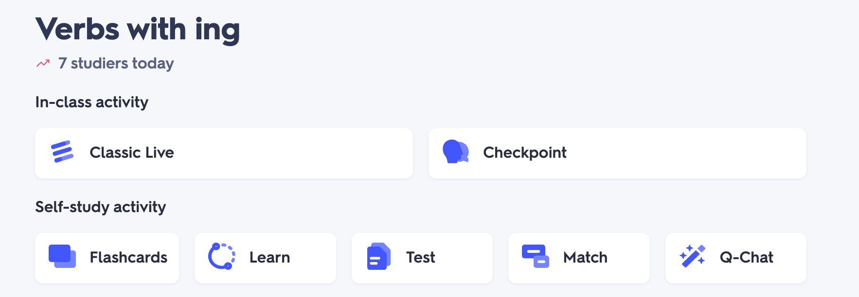
Quizlet
2. Games and Activities: Quizlet provides various interactive games and activities, such as matching games and quizzes. These activities transform the learning process into a fun challenge while reinforcing vocabulary and phrases.
https://quizlet.com/770858295/phrases-group-1-getting-to-know-you-phrases-spanish-vietnamese-and-thai-flash-cards/?funnelUUID=6ae89b24-0f3c-47e0-b97c-1c8b7edb51d5

Slide 8
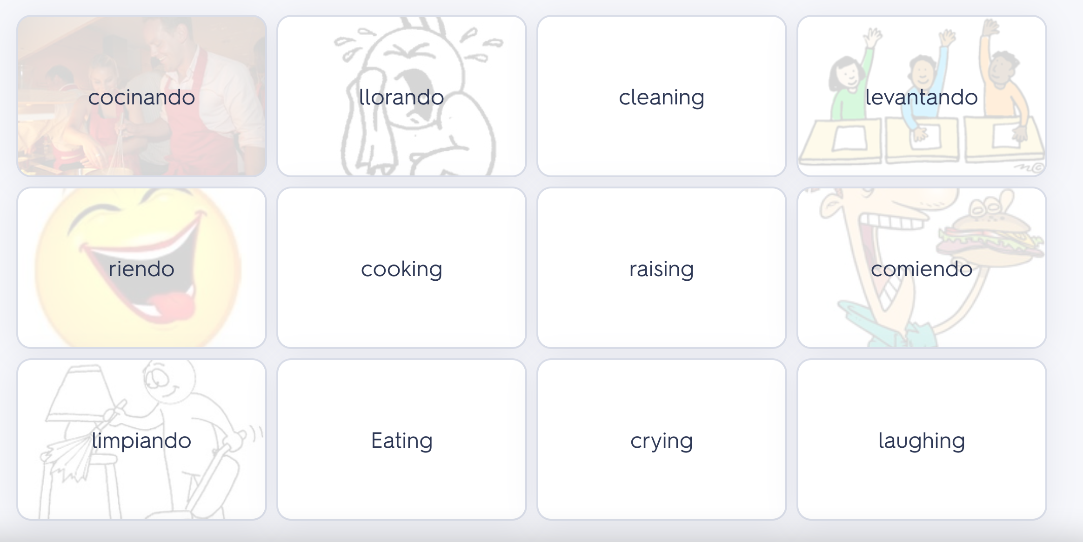
QUizlet
There are a variety of games that can be played.
Match is one game that my students enjoy. They especially enjoy playing in teams, on the Promethean board.

Slide 9
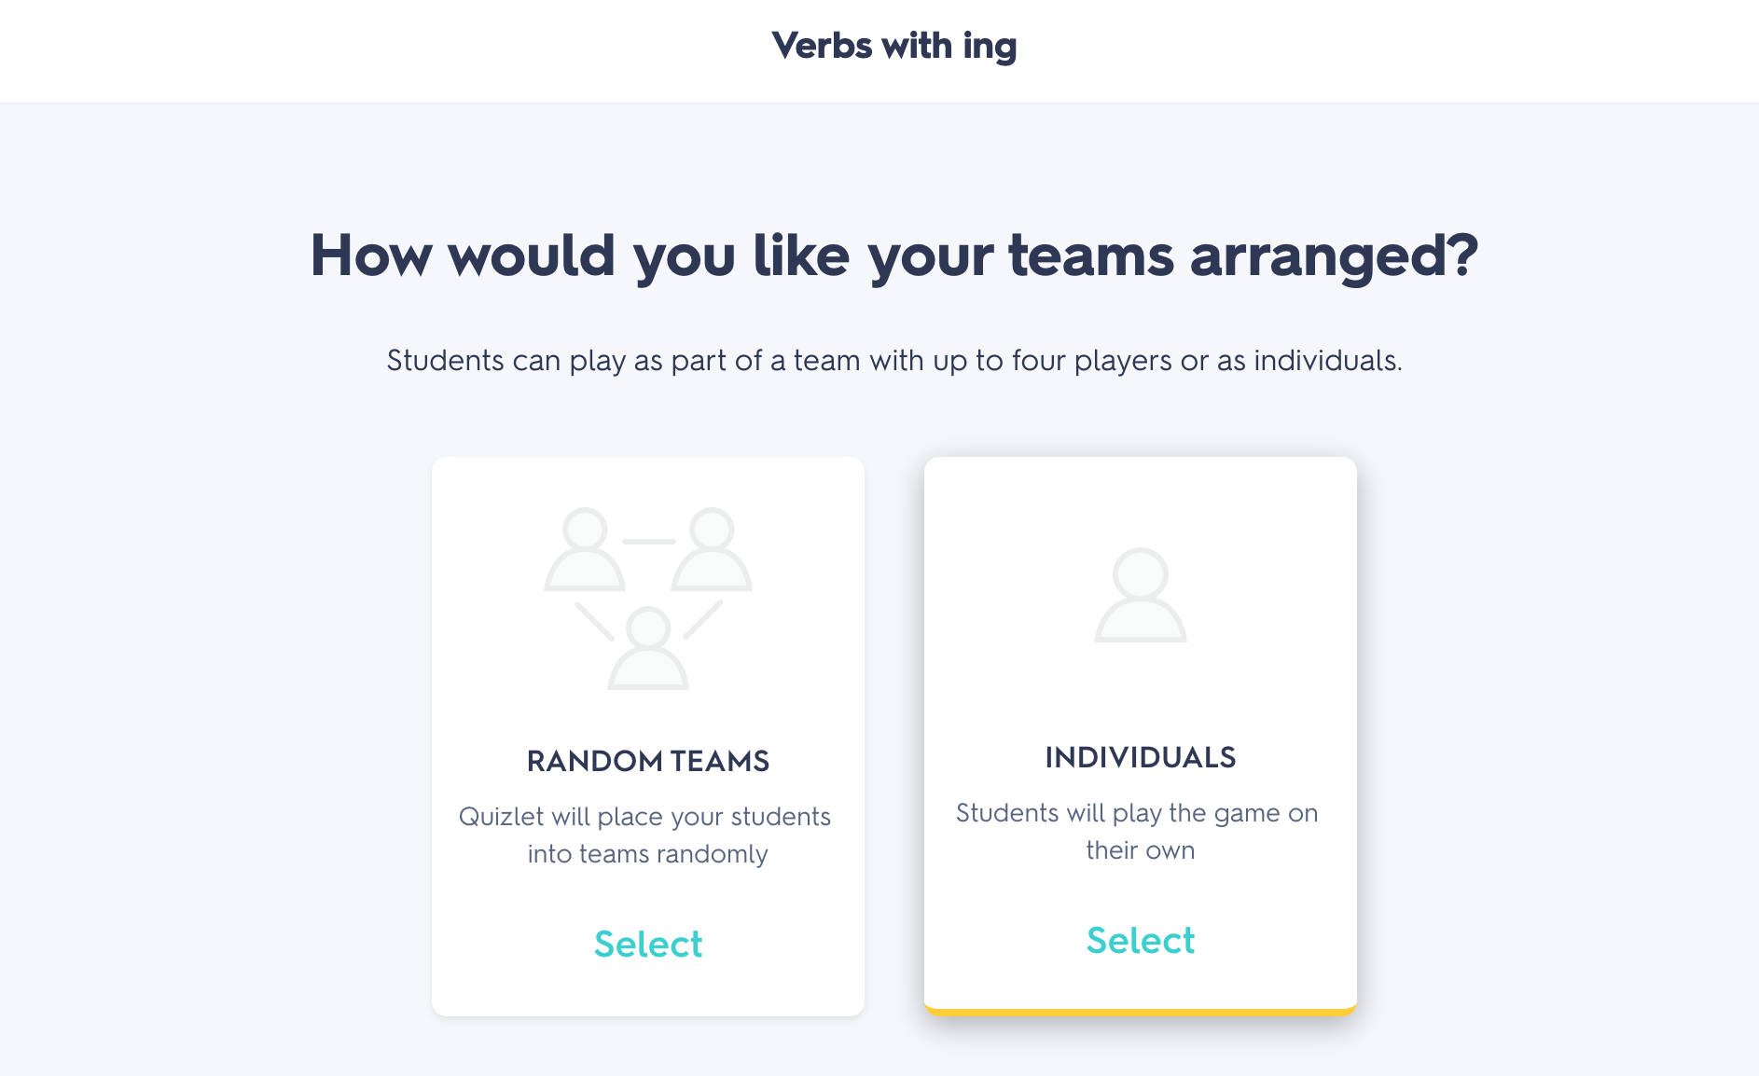
Quizlet
Quizlet is another valuable tool for gamifying the ESL learning experience. It focuses on vocabulary and terminology acquisition, making it particularly suitable for teaching phrases and vocabulary.
Games can be played in groups or individually.

Slide 10
quizlet
3. Audio Pronunciation: Pronunciation is a crucial aspect of language learning. Quizlet often includes audio pronunciation, helping ESL students, especially those reluctant to speak, to practice their pronunciation in a non-threatening environment.
https://quizlet.com/770858295/phrases-group-1-getting-to-know-you-phrases-spanish-vietnamese-and-thai-flash-cards/?funnelUUID=6ae89b24-0f3c-47e0-b97c-1c8b7edb51d5

Slide 11
Quizlet
4. Accessibility: Quizlet can be accessed through smartphones and computers, making it convenient for students to practice vocabulary and phrases at their own pace and on their preferred device.

Slide 12
Kahoot
Kahoot is a platform that allows you to create and play quiz-based games, making it an excellent choice for gamifying ESL learning. Here's how you can utilize Kahoot for teaching phrases and vocabulary to reluctant ESL students:

Slide 13
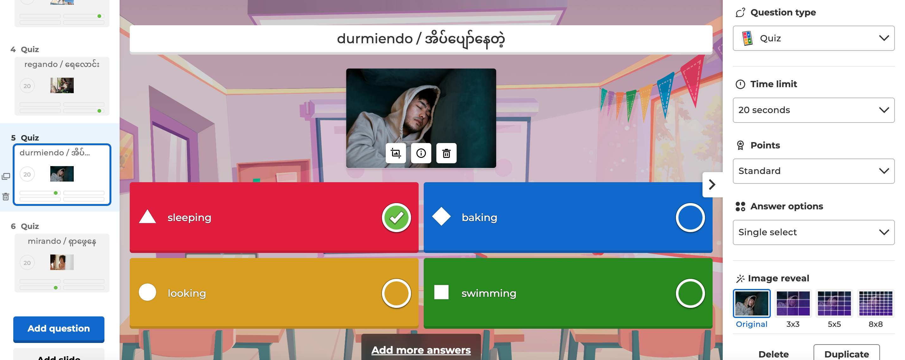
Kahoot
1. Engaging Quiz Creation: Teachers can create quizzes on Kahoot that feature phrases and vocabulary words. The game format, complete with colorful and animated elements, immediately captures the students' attention.

Slide 14
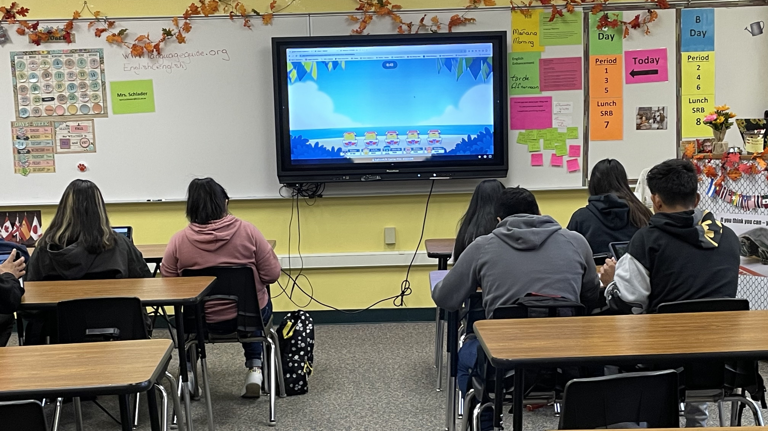
Kahoot
2. Competitive Element: ESL students, especially reluctant ones, often enjoy a competitive atmosphere. Kahoot offers this with its point-based scoring system and leaderboard, encouraging friendly competition among peers. This can be especially motivating for students who may be hesitant to participate.

Slide 15
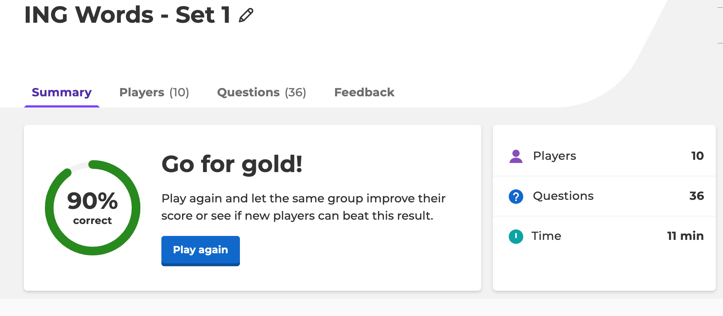
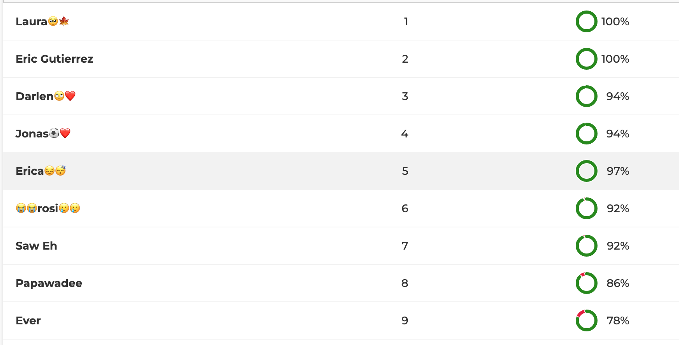
Kahoot
3. Immediate Feedback: Kahoot provides instant feedback after each question, allowing students to correct their mistakes and learn from them. This immediate reinforcement can boost their confidence and interest in learning English.

Slide 16
Kahoot
4. Inclusivity: Kahoot can be played in a group setting, which fosters a sense of community among students. Additionally, it accommodates diverse learning styles by using visual and auditory cues.

Slide 17
Kahoot
5. Customization: Teachers can tailor Kahoot quizzes to the specific level of their ESL students, ensuring that the content is neither too easy nor too difficult. This customization is essential for keeping reluctant learners engaged.

Slide 18
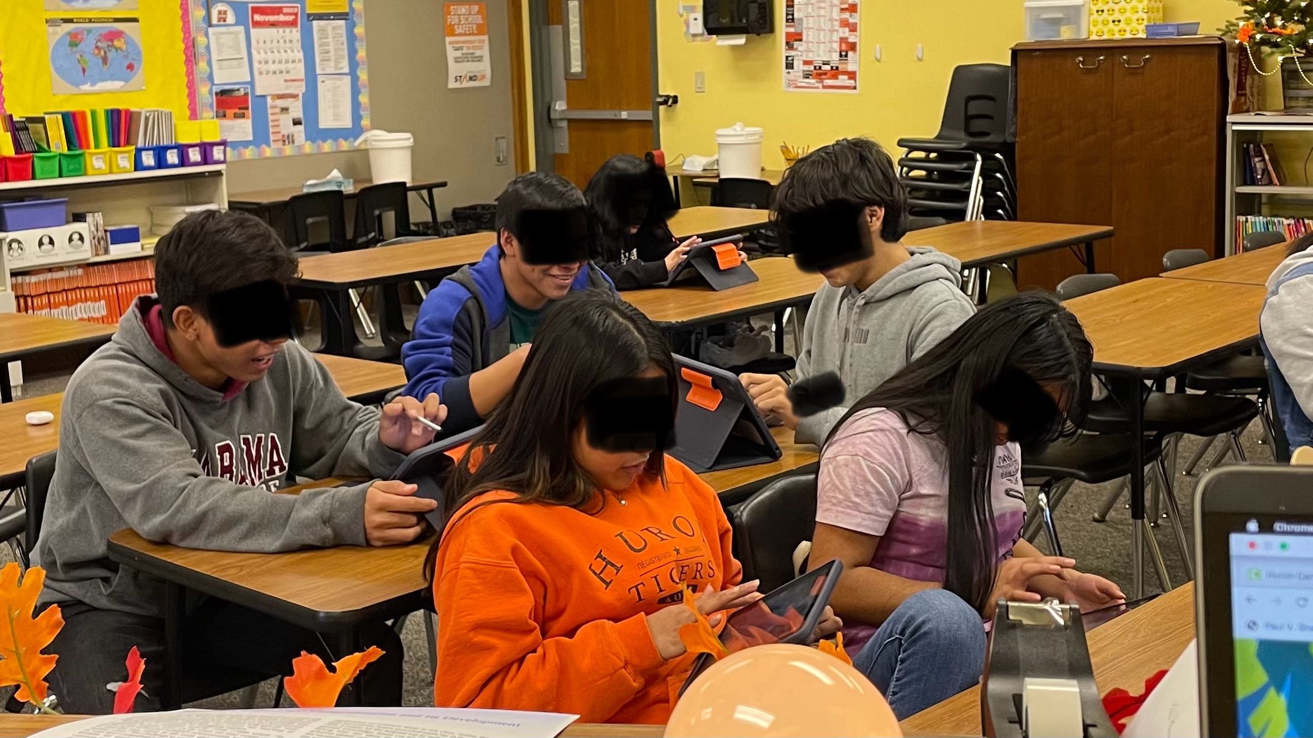
Kahoot
Combining Kahoot and Quizlet, ESL educators can create a comprehensive and engaging learning experience for reluctant students. By leveraging gamification, these platforms make the process of acquiring new phrases and vocabulary more enjoyable, interactive, and ultimately, more effective in helping ESL students

Slide 19
Let’s Play
https://play.kahoot.it/v2/?quizId=00a7dd97-d118-450c-a415-bf25c6b8e425

